Slide 1
Հիմա եռաչափ
…
Notes:
Now 3d

Slide 2
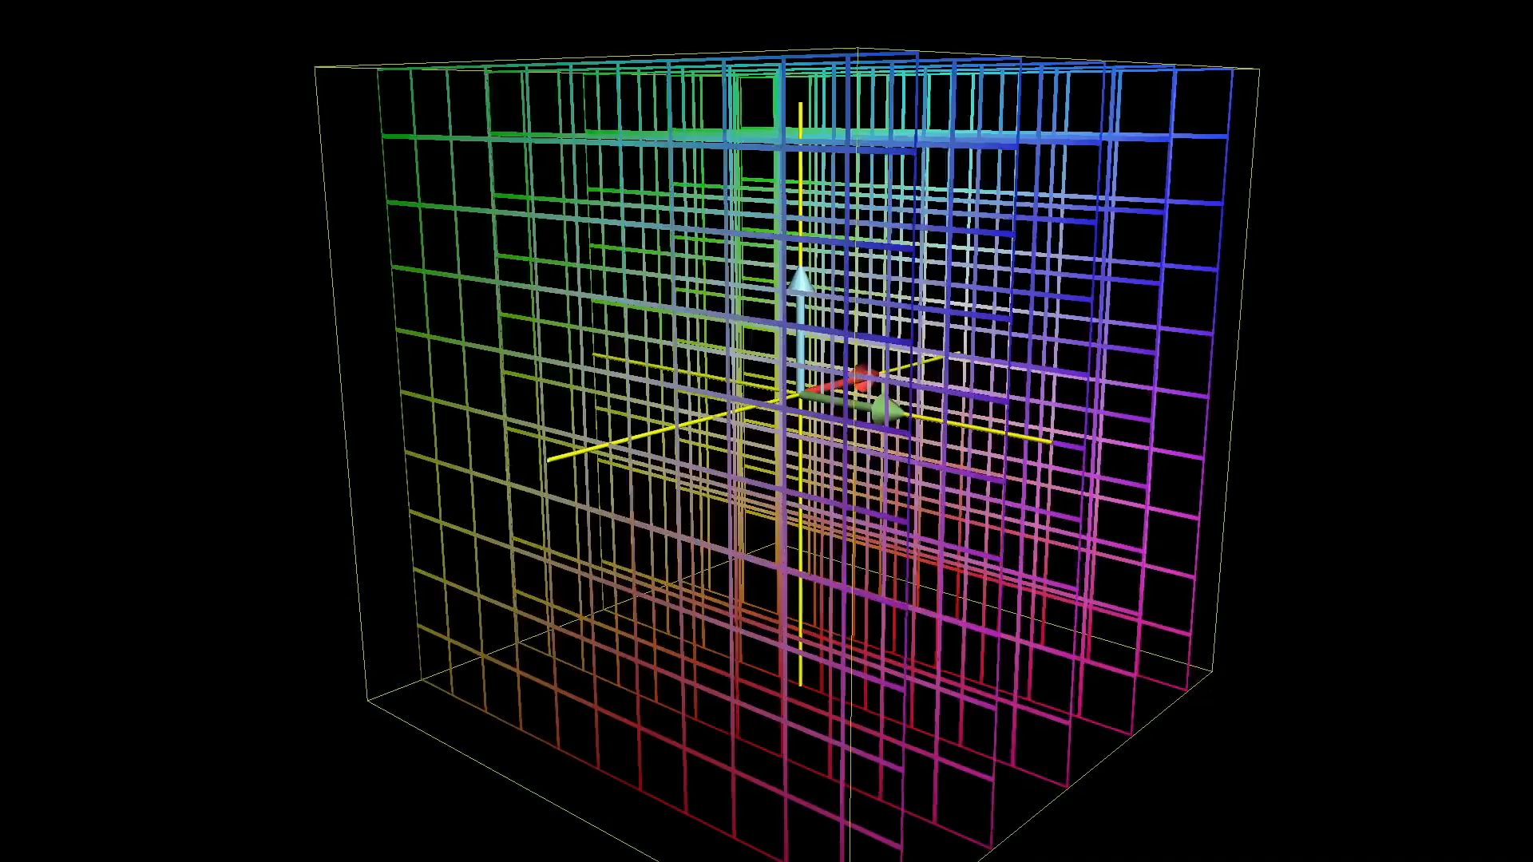
Notes:
3d transformation

Slide 3
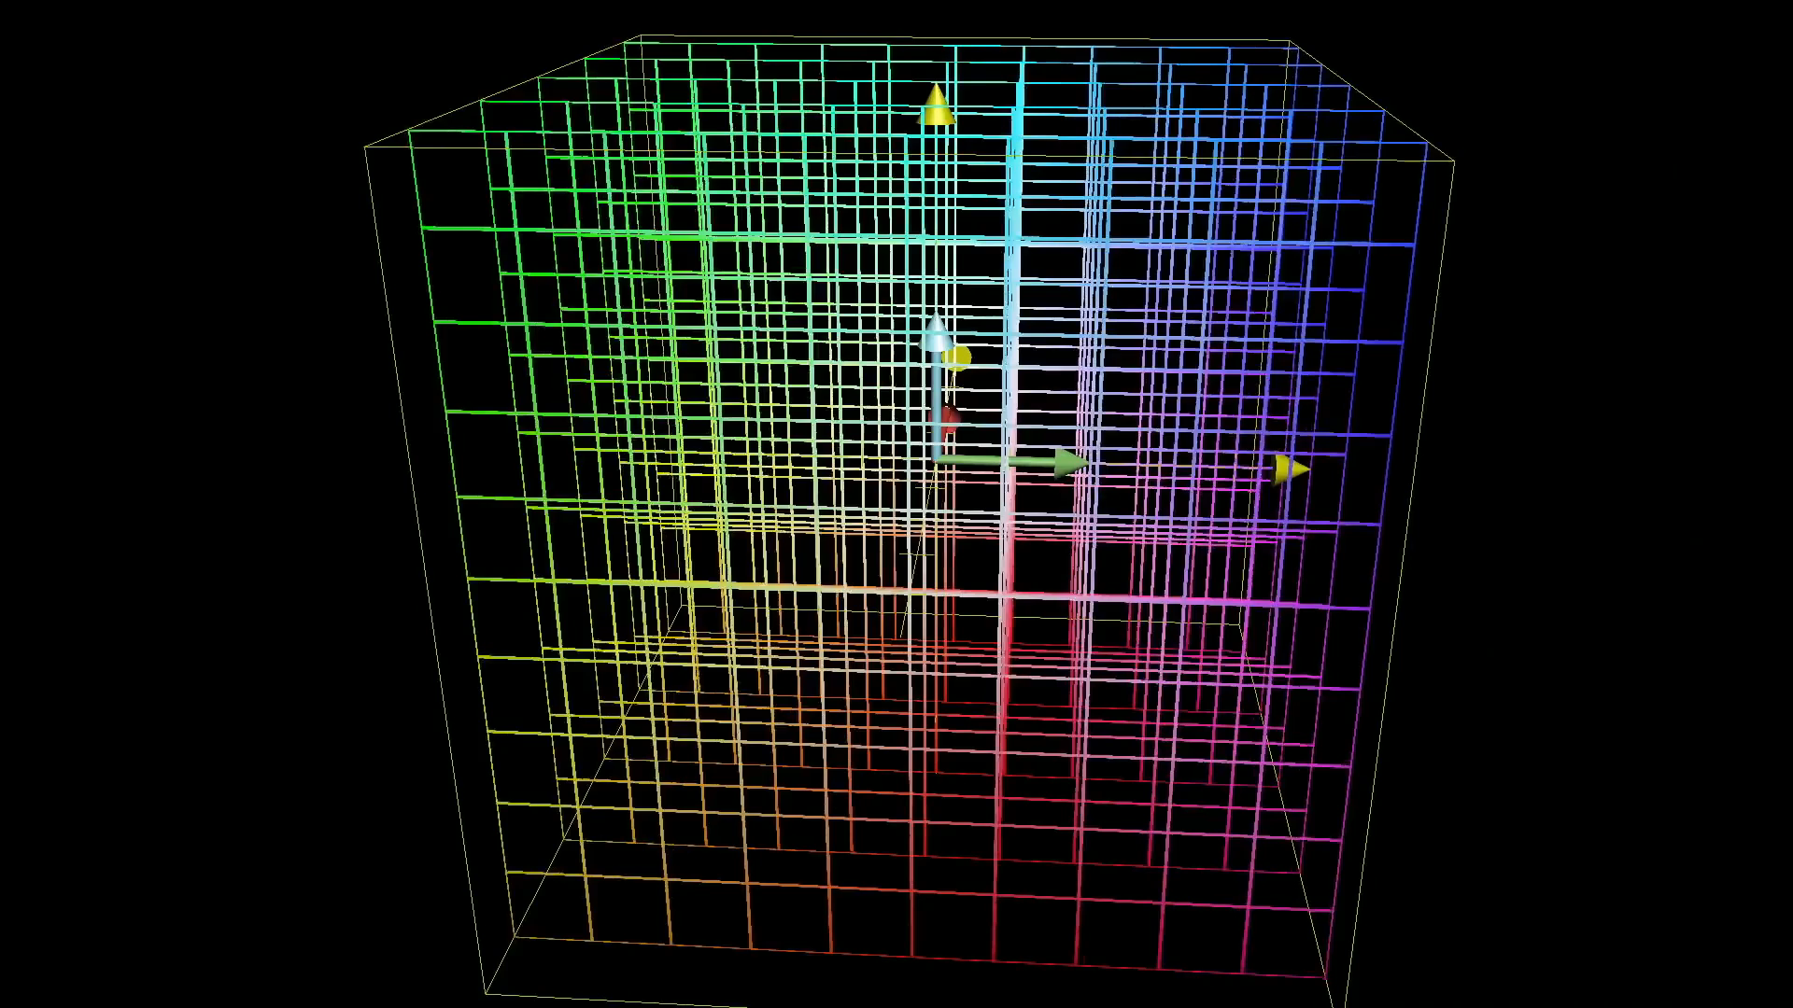
Notes:
Special box

Slide 4
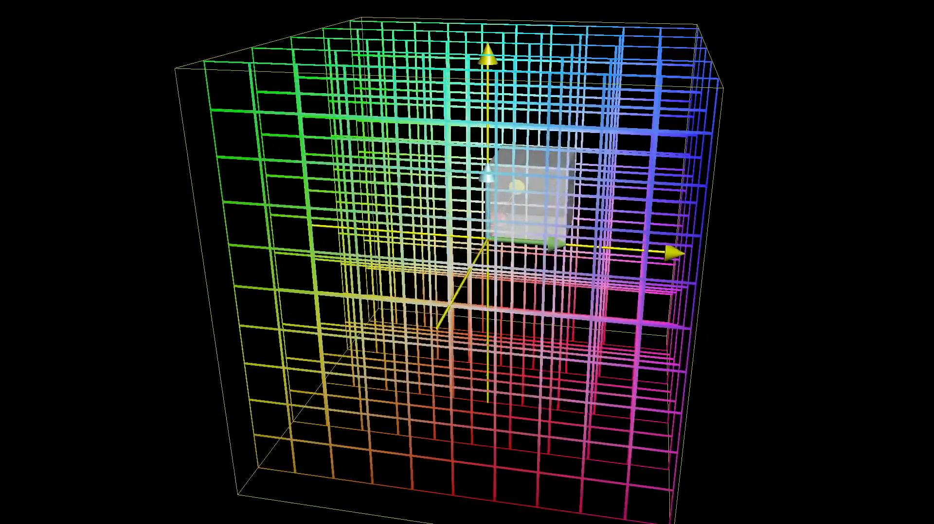
Notes:
Determinant is zero

Slide 5
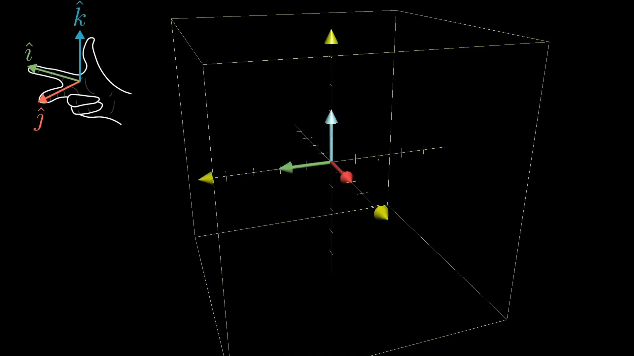
Notes:
Basis vector orientation

Slide 6
Իսկ ո՞նց հաշվենք
?
Notes:
Ask how to compute

Slide 7
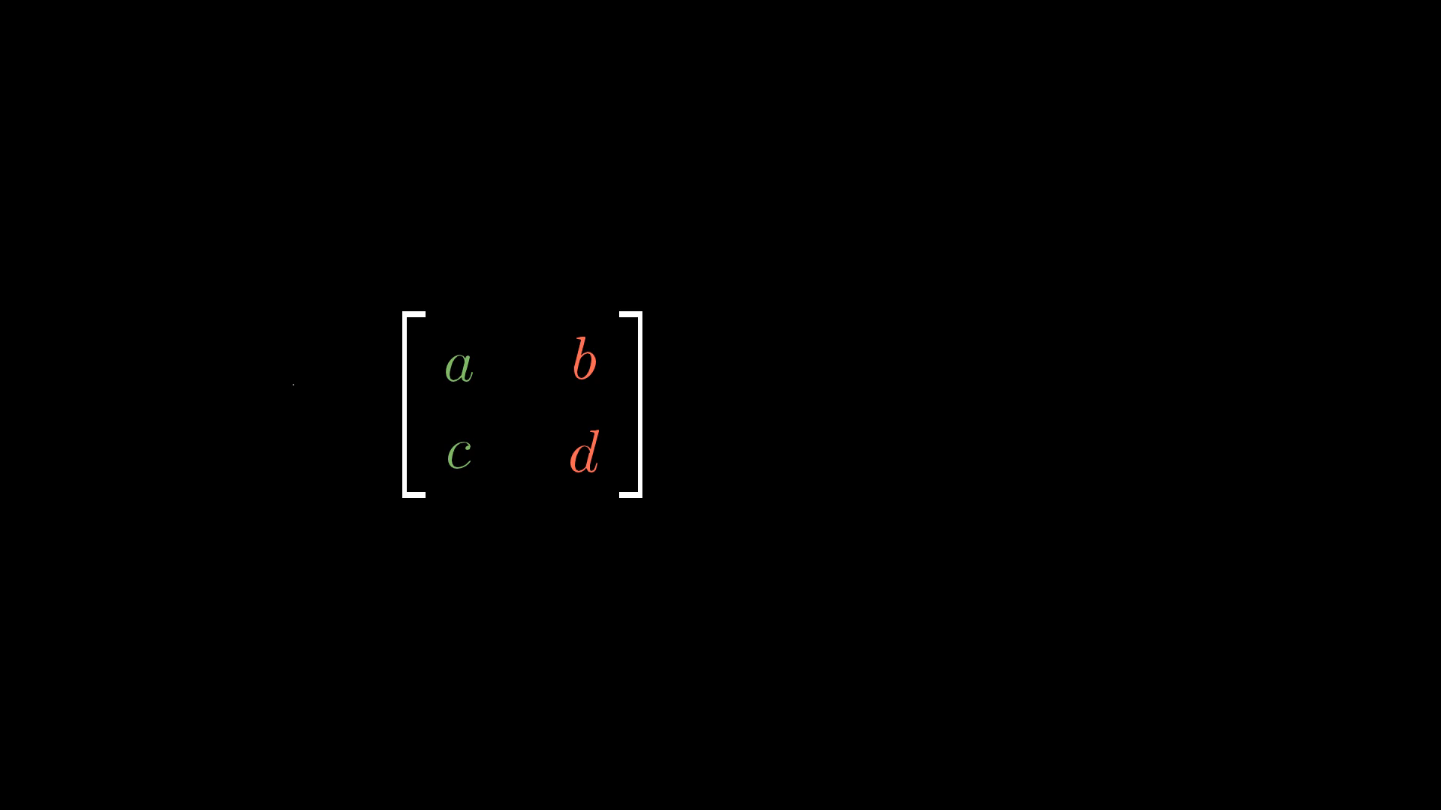
Notes:
2d determinant formula

Slide 8
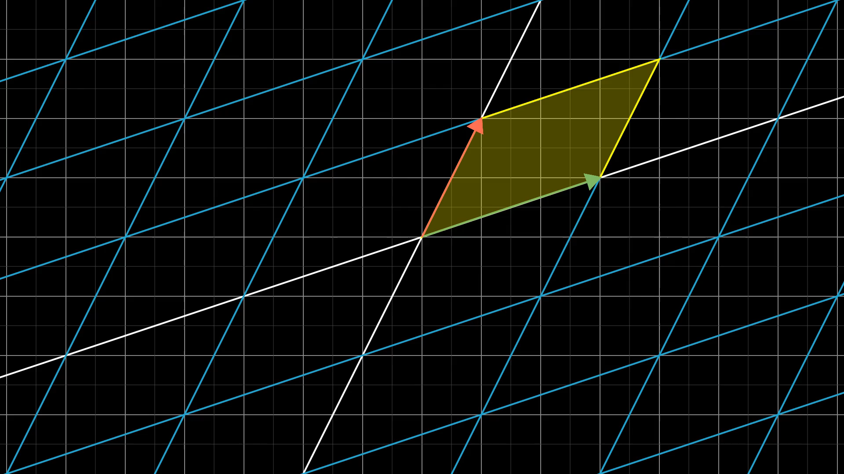
Notes:
Full formula explanation

Slide 9

Notes:
3d det formula

Slide 10
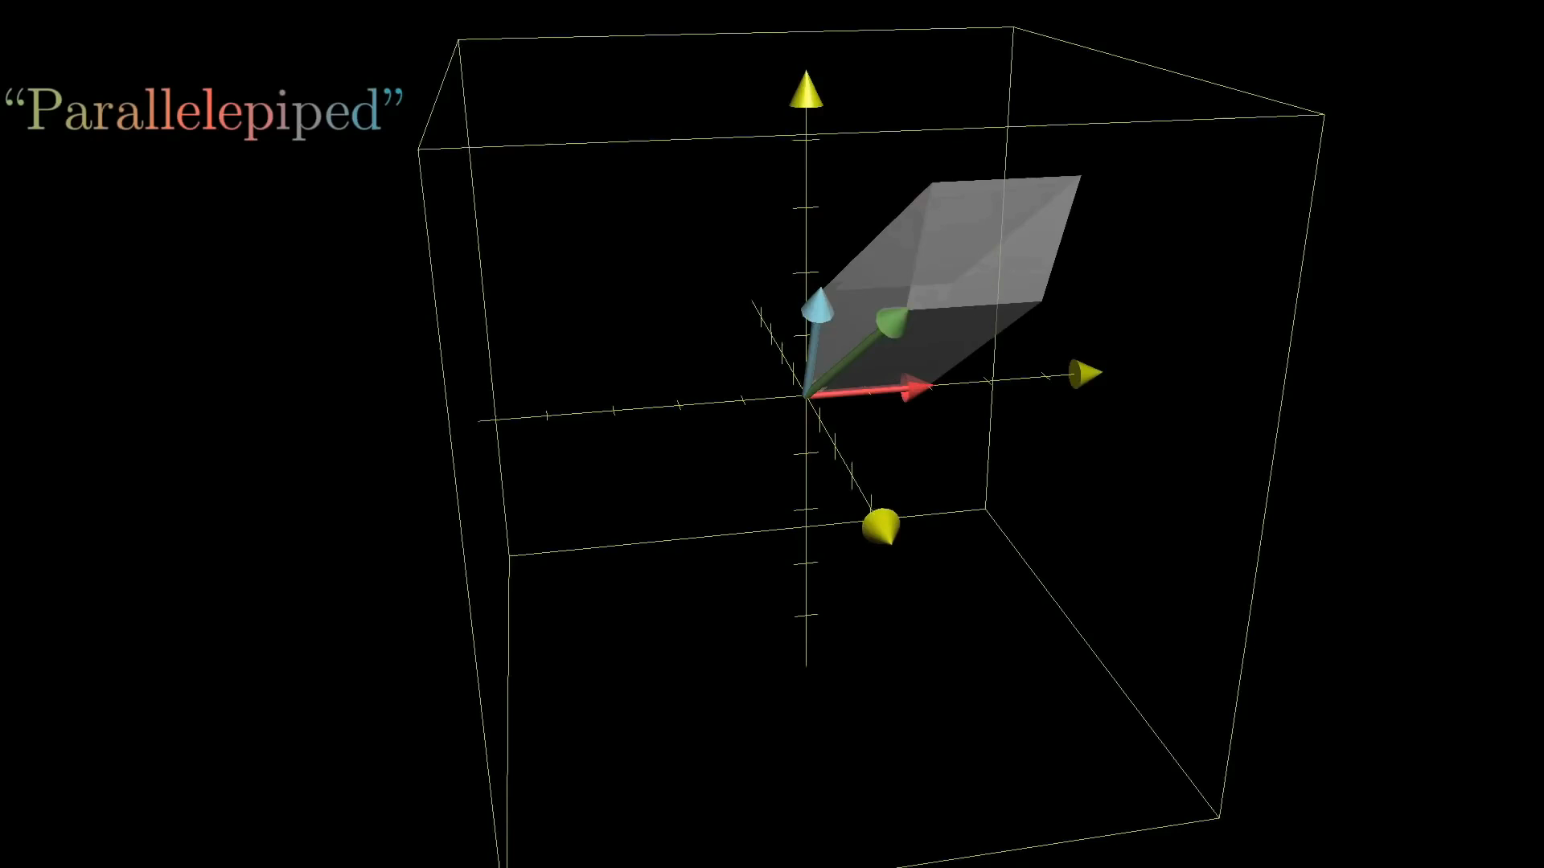
Notes:
Volume of parallelepiped

Slide 11
Notes:
Product property

